Slide 1

BRIGHT TELEVISION
Who's watching, who's not, and where to invest next
PRESENTED BY: Vhonani Mphoshomale

Slide 2

CONTEXT AND OBJECTIVES
OBJECTIVES COVERED
User & Usage Analysis
Content Performance & Drivers
CONTEXT
Low Consumption Segments
Comprehensive analysis of user profiles and viewership sessions from January to March 2016. This study identifies behavioral patterns and strategic growth levers for BrightTV.
Monthly Growth Trends
High Value User Profiling
10,000
4,386
2.3
TOTAL SESSIONS
UNIQUE USERS
AVG SESSIONS / USER

Slide 3

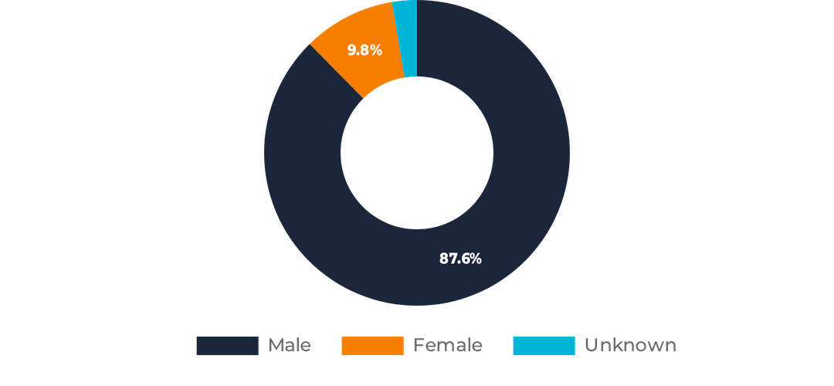
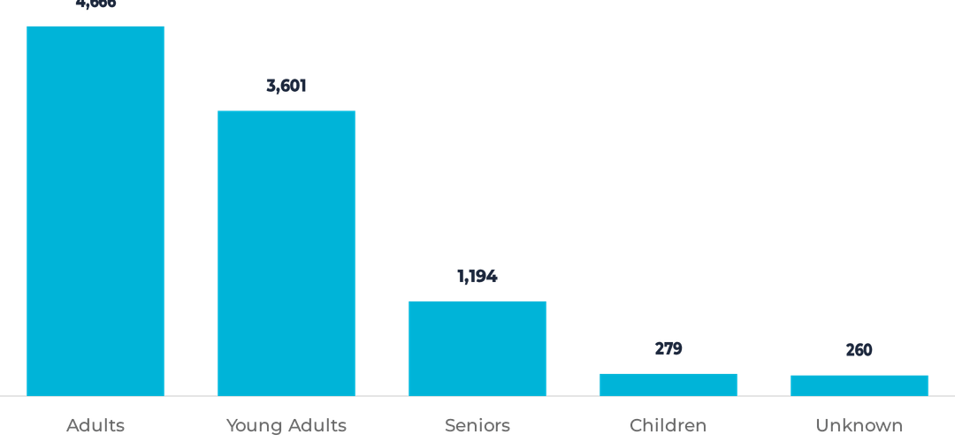
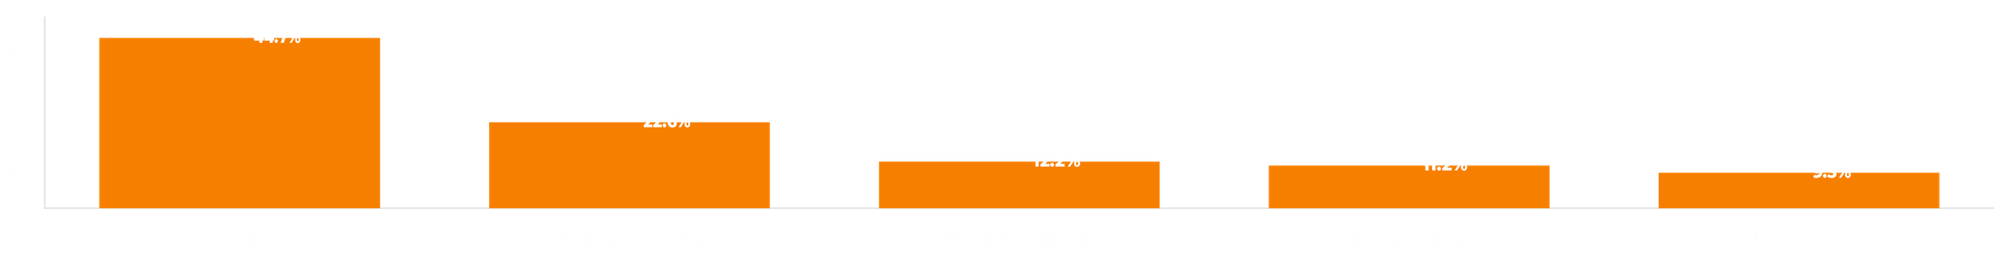
WHO IS THE BRIGHTTV AUDIENCE?
GENDER DISTRIBUTION
AGE GROUP ANALYSIS
Heavily male-dominated (87.6%) base, indicating a significant opportunity for female-focused content expansion.
Adults and Young Adults form 82.7% of the audience, driving the majority of platform engagement.
TOP 5 PROVINCES (REGIONAL CONCENTRATION)

Slide 4
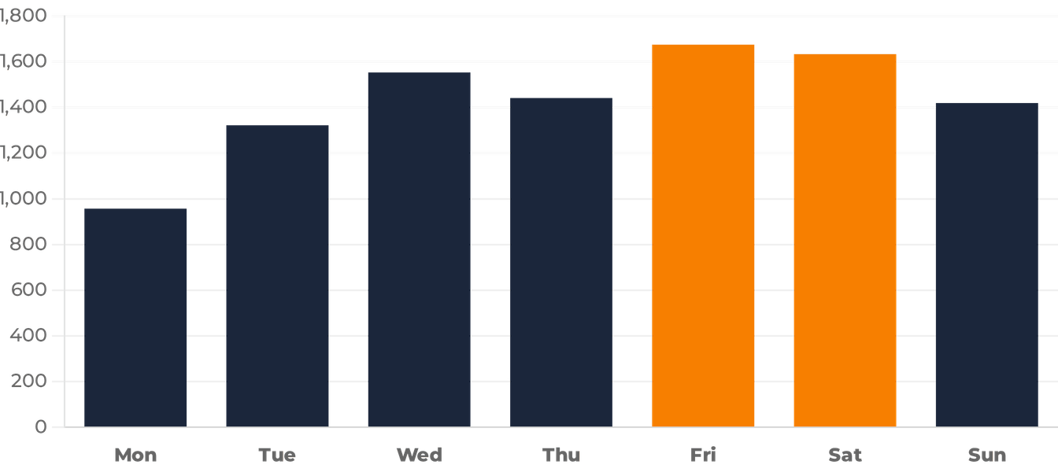
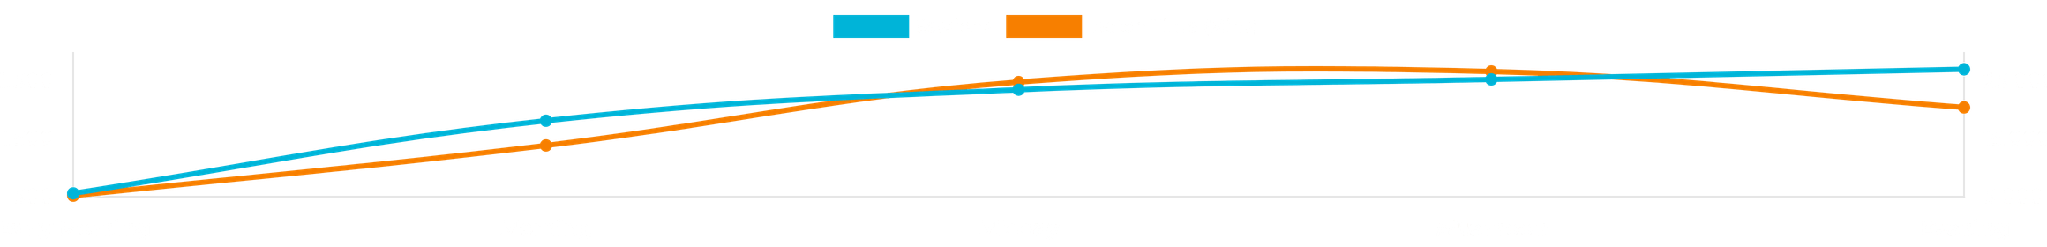
PEAK VIEWING PATTERNS
Weekend Peak
SESSIONS BY DAY OF THE WEEK
Engagement builds throughout the week, reaching maximum levels on Friday and Saturday.
Monday Slump
Monday represents the lowest engagement point (957 sessions), indicating a clear start-of-week drop-off.
DAILY ENGAGEMENT: SESSIONS VS. WATCH TIME

Slide 5
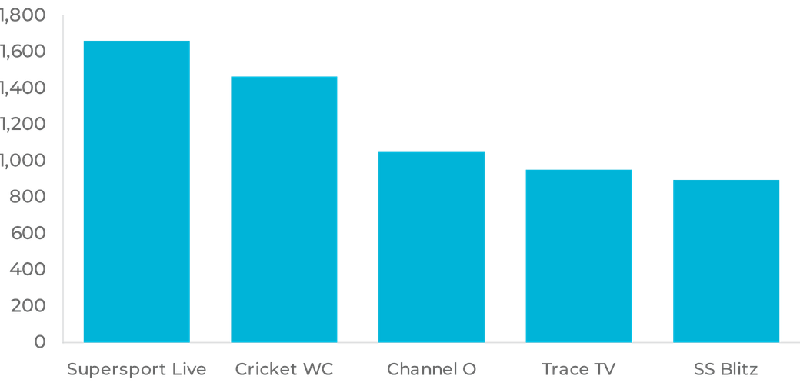
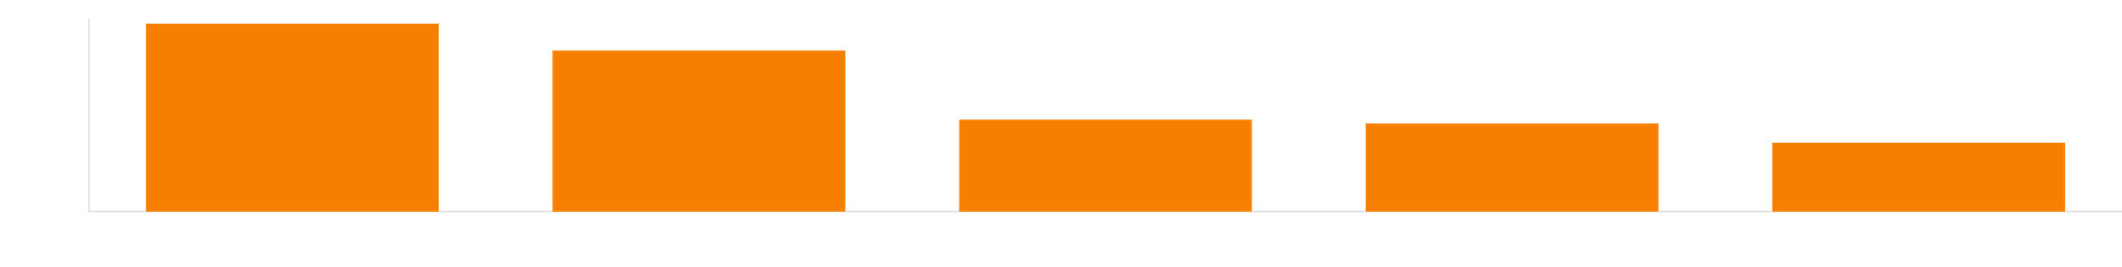
CONTENT PERFORMANCE
Sports Dominance: Supersport Live Events and Cricket World Cup 2011 account for over 31% of total platform sessions.
TOP 5 CHANNELS BY SESSIONS
Music & Lifestyle: Channel O and Trace TV maintain strong secondary engagement, particularly among younger demographics.
Engagement Driver: Live sporting events serve as the primary acquisition tool for the platform.
TOP CHANNELS BY WATCH TIME (MINUTES)

Slide 6
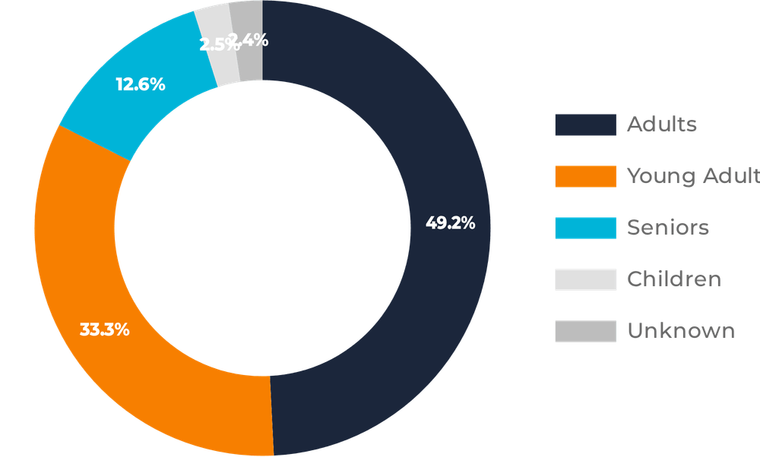
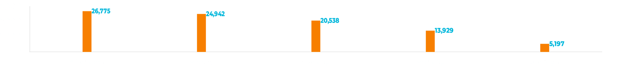
CONSUMPTION DRIVERS
CORE AUDIENCE IMPACT
Adults and Young Adults contribute a combined 82.5% of total platform watch time.
ENGAGEMENT CONCENTRATION
Adults alone drive nearly half (49.2%) of all consumed minutes, making them the most valuable segment.
WATCH MINUTES PER TIME OF DAY

Slide 7

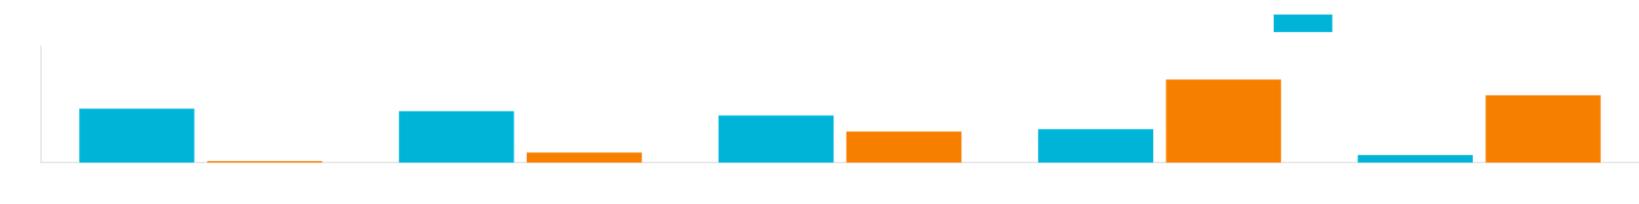
THE ENGAGEMENT GAP
The Pareto Effect: Just 21.2% of users (Engaged & Power) drive nearly 78% of total viewing time, highlighting a massive opportunity to activate the mid-tier.
54.5%
of Users are Barely Watching
The majority of the user base (Dormant and Light segments) contributes less than 6% of total platform watch time.

Slide 8
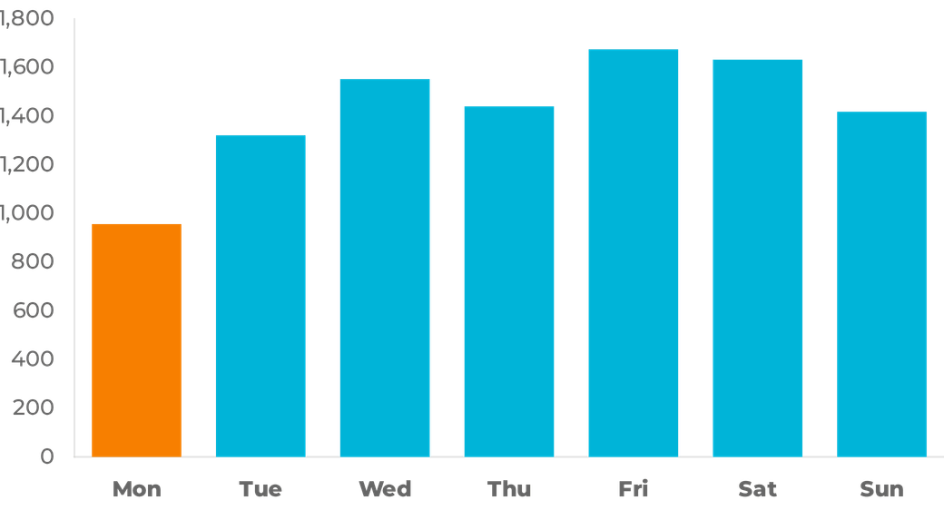
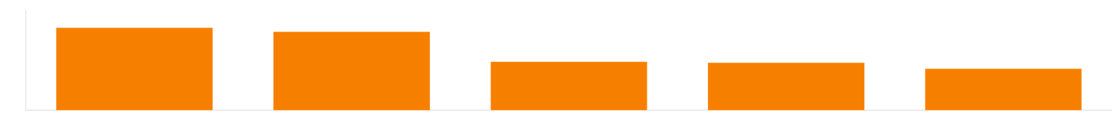
PROFILING LOW-CONSUMPTION USERS
SESSIONS BY DAY OF THE WEEK
BEHAVIORAL INSIGHTS
Low-consumption users exhibit sporadic viewing habits, primarily tuning in for major live events but failing to maintain daily engagement.
The Monday Slump is most pronounced in this segment, with engagement dropping significantly at the start of the work week.
TOP CHANNELS FOR LOW-CONSUMPTION USERS

Slide 9
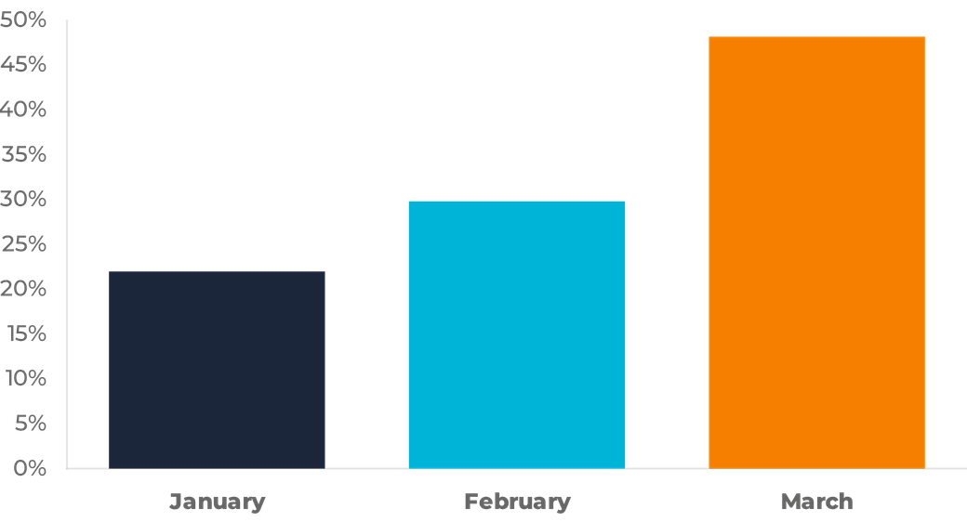
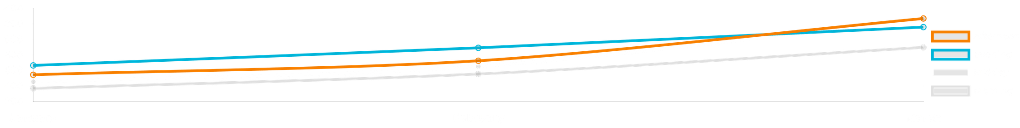
THE CRICKET EFFECT & MONTHLY GROWTH
STRATEGIC INSIGHTS
The platform experienced a strong upward trend, with sessions increasing from 22% in January to over 48% in March.
MONTHLY SESSION DISTRIBUTION
This growth is directly correlated with major sporting events, specifically the ICC Cricket World Cup, which acted as a massive engagement catalyst.
MONTHLY TREND VS. TIME OF DAY

Slide 10

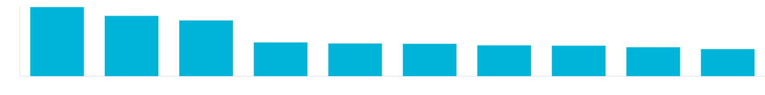
HIGH VALUE USERS
RETENTION PRIORITY
These users are the platform's primary value drivers. Stability in this segment is essential for sustained growth and revenue.
STRATEGIC IMPORTANCE
A critical core of Power Users (just 3.9% of the base) drives over 34.8% of total platform watch time.
TOP 10 USERS BY WATCH TIME (MINUTES)

Slide 11






STRATEGIC RECOMMENDATIONS
OPTIMIZE PEAK TIMES
→
Focus marketing on Afternoon & Evening
→
Schedule flagship releases during peaks
STRENGTHEN CONTENT
→
Maximize ad revenue during high-watch slots
→
Double down on premium sports rights
→
Expand entertainment & lifestyle library
→
Balance the content mix for broader appeal
GROWTH
PRECISION
ENGAGEMENT

Slide 12
IMPROVING RETENTION
REWARD PLATFORM LOYALTY
Offer exclusive early access or loyalty rewards for the top 20% of users who drive nearly 80% of platform value.
ACTIVATE THE DORMANT BASE
Implement personalized recommendations and improved content discovery to bridge the engagement gap for the 54.5% under-engaged users.
DIVERSIFY CONTENT MIX
Leverage sports peaks to cross-promote entertainment and lifestyle content, increasing session frequency across all demographics.
COUNTERACT THE MONDAY SLUMP
Launch specific "Content Drops" or limited-time promotions on Mondays to incentivize start-of-week viewing.
REGIONAL EXPANSION STRATEGY
55.3%
Target growth outside of Gauteng with localized marketing campaigns in Western Cape and KwaZulu-Natal to diversify the regional footprint.
NON-GAUTENG POTENTIAL

Slide 13




CONCLUSIONS
CORE AUDIENCE
USAGE PEAKS
GROWTH POTENTIAL
Engagement is firmly driven by Adults and Young Adults, with sports content leading platform performance.
Viewing peaks during leisure times and later in the week, with significant drop-offs observed on Mondays.
The platform shows steady growth, with major opportunities to activate the 54.5% under-engaged user base.
PLATFORM TRAJECTORY
BrightTV is positioned for high-value expansion by leveraging its sports core to diversify content and regional reach.

Slide 14

THANK YOU
QUESTIONS?
CONTACT FOR FURTHER ANALYSIS
Vhonani Mphoshomale

